Slide 1

Customer Shopping Behavior Analysis
3,900 purchases • 18 features • Actionable insights

Slide 2

Dataset Summary
Rows
Columns
Missing
3,900
18
37 review ratings

Slide 3

Exploratory Data Analysis (Python)
Engineer
Clean
age_group, purchase_frequency_days
Load & Inspect
Impute review ratings by category median
pandas: df.info(), .describe()

Slide 4

SQL Analysis (PostgreSQL)
Revenue by Gender
Male $157,890 • Female $75,191
Subscribers
Yes: 1,053 avg $59.49 • No: 2,847 avg $59.87

Slide 5




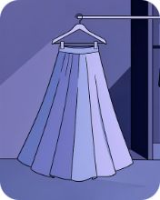
Top Products & Ratings
Gloves
Sandals
Boots
Hat
Avg rating 3.86
Avg rating 3.84
Avg rating 3.82
Avg rating 3.80
Skirt
Avg rating 3.78

Slide 6
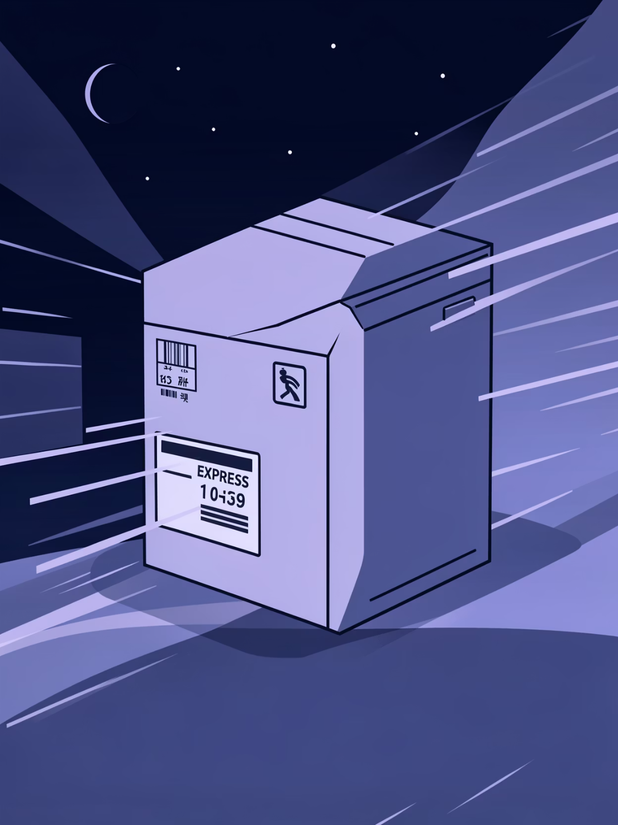
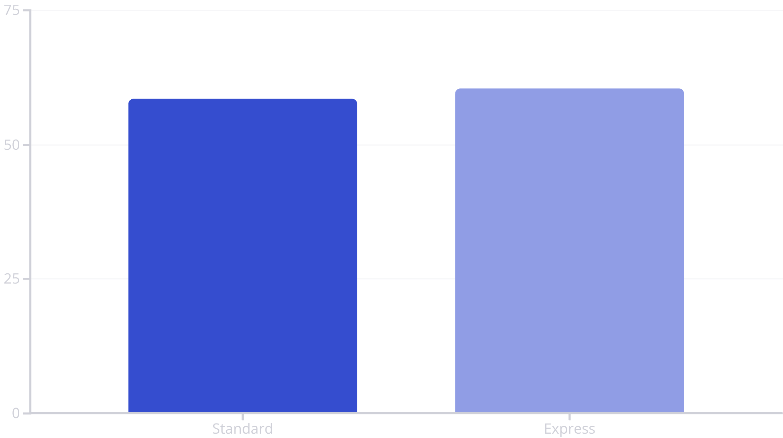
Shipping & Spend
Express slightly higher average spend

Slide 7


Customer Segments
Loyal
3,116 customers
Returning
701 customers
New
83 customers

Slide 8


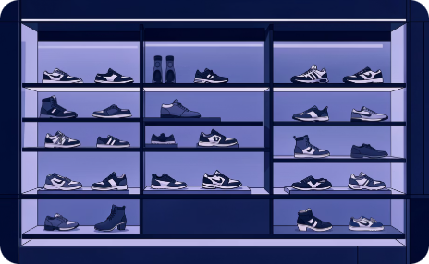
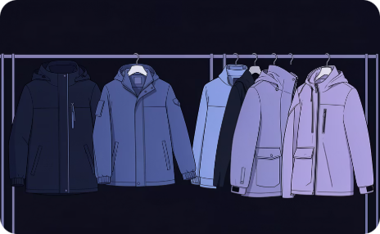
Revenue & Sales by Category
Clothing
Accessories
Footwear
Outerwear
Revenue $100K • Sales 2,000
Revenue $70K • Sales 1,500
Revenue $30K • Sales 700
Revenue $20K • Sales 400

Slide 9

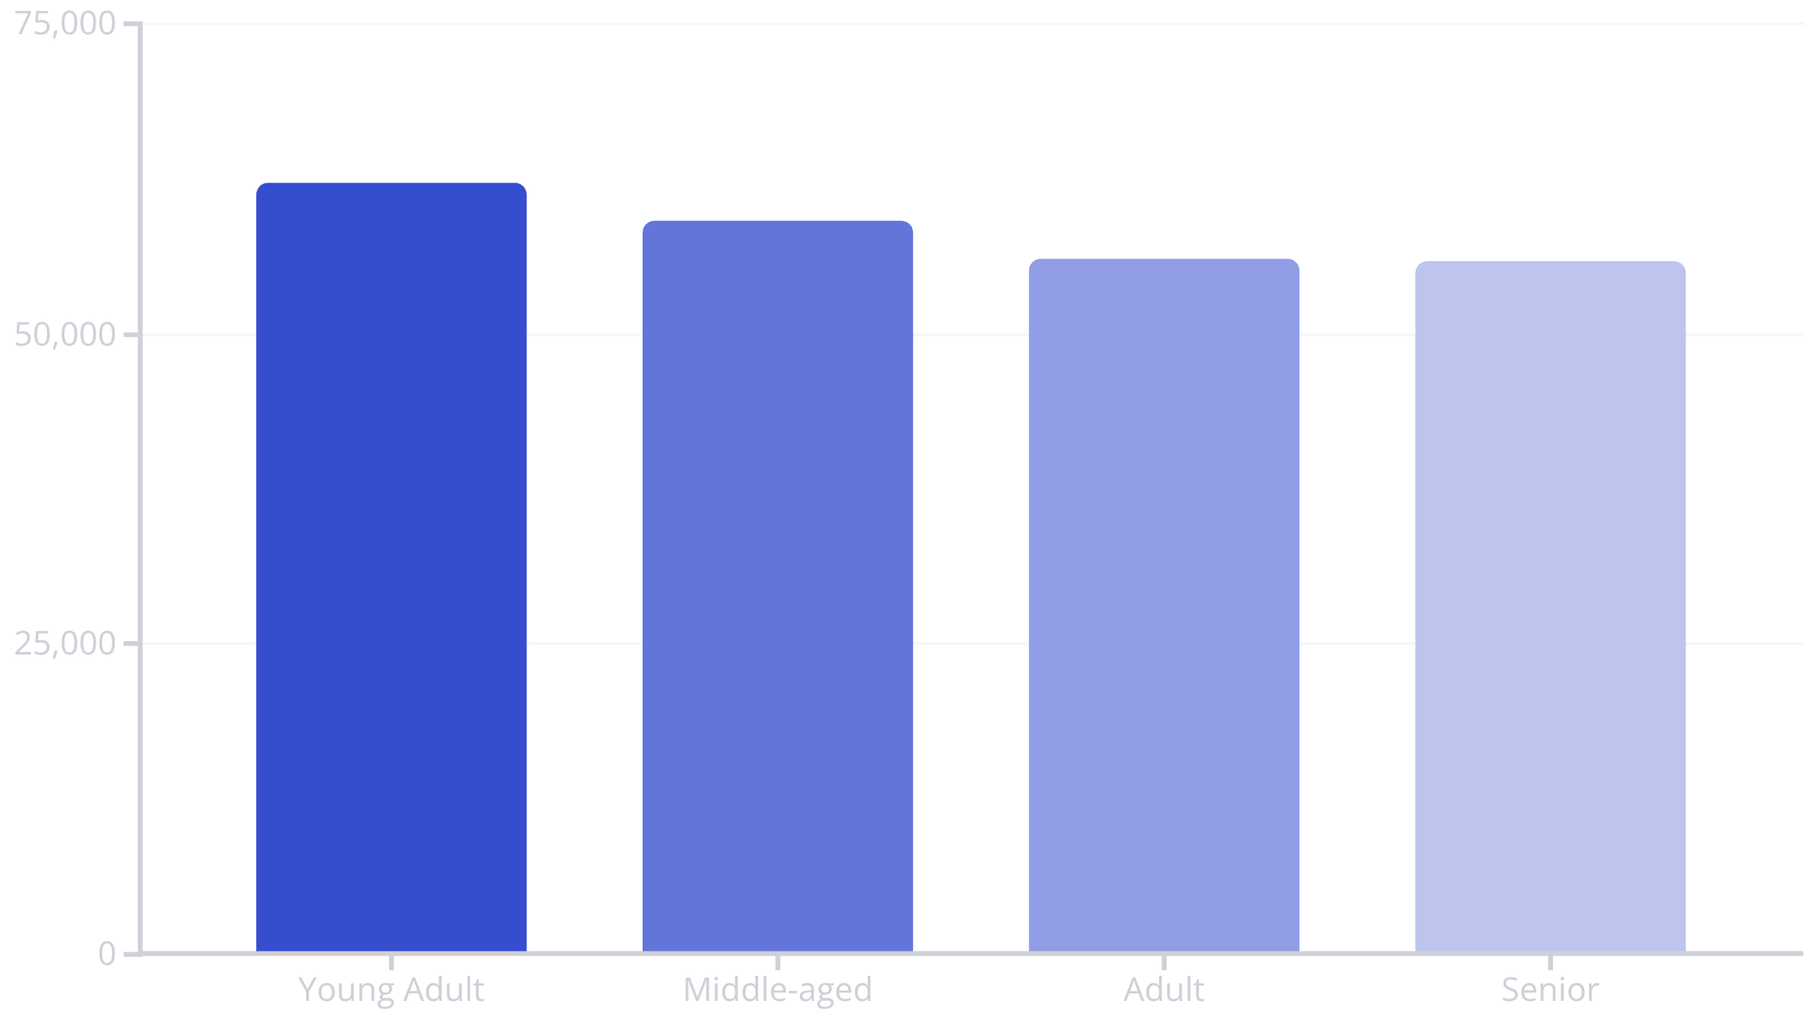
Revenue by Age Group
Focus marketing on high-revenue groups

Slide 10
Recommendations
Boost Subscriptions
Loyalty Programs
Review Discounts
Product Positioning
Reward repeat buyers to grow Loyal segment
Balance promotions with margin control
Promote exclusive subscriber benefits
Highlight top-rated & best-sellers
Targeted Marketing
Focus on high-revenue ages & express-shipping users

